Slide 1
INFDEV026A - Algoritmiek Week 6
G. Costantini, F. Di Giacomo, G. Maggiore
costg@hr.nl, giacf@hr.nl, maggg@hr.nl – Office H4.204

Slide 2
Today
Why is my code slow?
Empirical and complexity analysis
How do I order my data?
Sorting algorithms
How do I structure my data?
Linear, tabular, recursive data structures
How do I represent relationship networks?
Graphs

Slide 3
More detailed agenda
What is dynamic programming?
Fibonacci example; memoization and bottom-up approaches
How can we find the shortest paths between all pairs of nodes in a graph?
Floyd Warshall algorithm

Slide 4
Dynamic Programming
Fibonacci sequence, Memoization, Bottom up, General idea

Slide 5
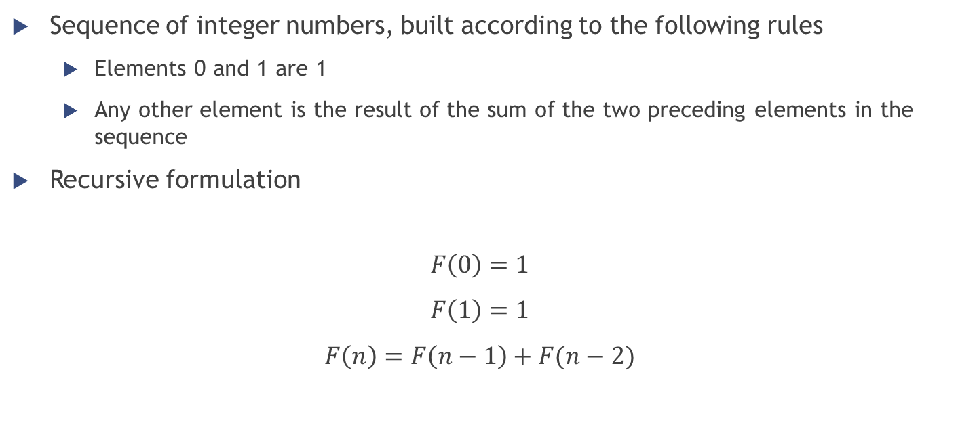
Fibonacci Sequence Definition
Sequence of integer numbers, built according to the following rules
Elements 0 and 1 are 1
Any other element is the result of the sum of the two preceding elements in the sequence
Recursive formulation
$$F\left(0\right)=1$$
$$F\left(1\right)=1$$
$$F\left(n\right)=F\left(n−1\right)+F(n−2)$$

Slide 6
Fibonacci Sequence Recursive function
function fib(n)
if n <= 1 return 1
return fib(n − 1) + fib(n − 2)
n | Time (ms)
30 | 4
35 | 50
40 | 551
45 | 3792
>50 | Happy watching!

Slide 7

Fibonacci Sequence Why so slow?
F(5)
F(4)
F(3)
F(3)
F(2)
F(2)
F(1)
F(2)
F(1)
F(1)
F(0)
F(1)
F(0)
F(1)
F(0)
Complexity = $O(2^{n})$

Slide 8
Fibonacci Sequence Why so slow?
“Did I ever tell you what the definition of insanity is? Insanity is doing the exact... same *** thing... over and over again expecting... things to change...”
We are doing the same thing over and over again
F(3) computed twice, F(2) computed three times...
Ideas on how to speed up the process?
We could save the result of sub-problems (= memoization)!

Slide 9
Fibonacci Sequence Memoization
Save the result of sub-problems into a data structure (called lookup table)
Before making a recursive call, we check the lookup table…
Sub-problem never solved yet? → Make the recursive call
Sub-problem already solved? → Read the result stored in the table
Add the result of the current recursive call to the lookup table

Slide 10
Fibonacci Sequence Memoized algorithm (recursive)
Suppose m is a map object which maps each value of fib that has already been calculated to its result
var m := map(0 → 1, 1 → 1)
function fib(n)
if key n is not in map m
m[n] := fib(n − 1) + fib(n − 2)
return m[n]

Slide 11
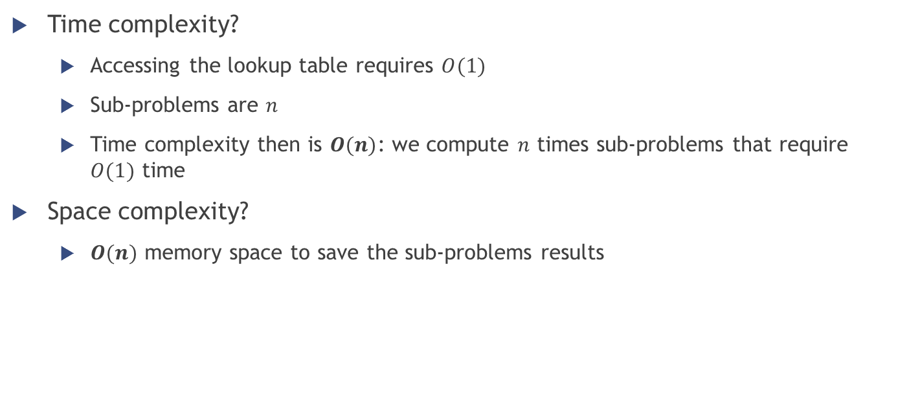
Fibonacci Sequence Memoization
var m := map(0 → 0, 1 → 1)
function fib(n)
if key n is not in map m
m[n] := fib(n − 1) + fib(n − 2)
return m[n]
Time complexity?
Accessing the lookup table requires $O(1)$
Sub-problems are $n$
Time complexity then is $O(n)$: we compute $n$ times sub-problems that require $O(1)$ time
Space complexity?
$O(n)$ memory space to save the sub-problems results

Slide 12

Fibonacci Sequence Bottom up algorithm (iterative)
Other possible approach
Build the result of the computation starting from the base case of the recursion
At each iteration save the intermediate results to use at the next step
Same time complexity $O(n)$ as the recursive version, but only $O(1)$ of space complexity
function fib(n)
if n = 0
return 1
else
var previousFib := 1, currentFib := 1
repeat n − 1 times // loop is skipped if n = 1
var newFib := previousFib + currentFib
previousFib := currentFib
currentFib := newFib
return currentFib

Slide 13
Floyd Warshall algorithm

